Slide 1
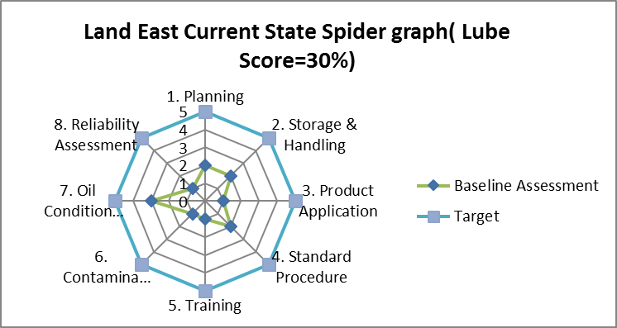
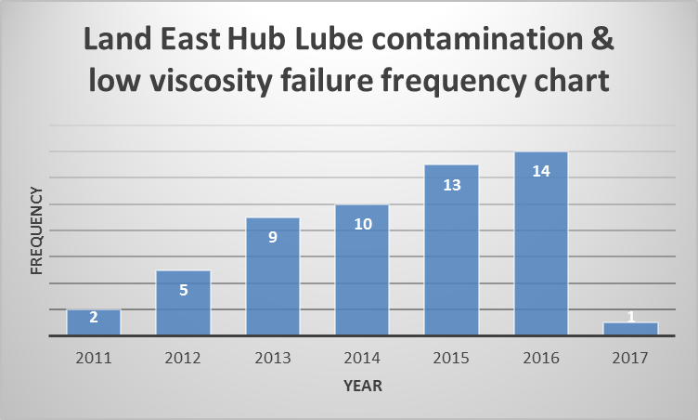
PROJECT TITLE : LUBRICATION MANAGEMENT EXCELLENCE ( LME )
Train and appoint Lube technology Champions in each district
Review and update existing lube management programme
Regular sampling analysis
Regular supply of required lubricant
Review and update lube components of the existing PM
Provide functional lube storage and handling facilities and equipment.
Define and build field staff capabilities and capacity in lube oil management
Integrate the lubrication Program into the plant’s preventive & predictive goals.
Continue SOS and introduce 5S programme to improve house keeping practice
Develop credible yearly consumption data with support from the hubs and MM team and share with vendors and key blending plants for planning purposes in view of current lead times (currently ongoing)
Review warehouse lubricant storage conditions to ensure their aligned with global and manufacturer storage requirements
Impact of the Problem/Business Case
Solution/Improvement
Actual/ Current State
Technology champion is absent
Vivo Energy now supplies Lubricants replacing Shell Ghana.
Dispensing containers are kept open when not in use
Use of same dispensing container to dispense all lubricants
In the facilities, containers and/or hoses have proper marking gap to prevent lubricant misapplication.
Logistics transports lube from the warehouse to the various assets.
Production chemistry take lube samples and analysis on demand from the asset
Drums are kept in vertical positions instead of 3 and 9 o’clock positions.
Lubricant storage facilities allows water and dust ingress.
Circa $214k Maintenance cost was spent on Lube related failures from 2011 to 2016 and $85k in Q1 2017.
The cost of the failure will be much if deferment and labor cost are included.
Lubrication problem occurs virtually in all facilities across Land East Hub but Imo River and Agbada assets are the major culprit from the analysis. See attached SAP data analysis.
Challenges with incomplete customs clearance documentation.
Low coverage of lubricant items on the current price agreement for lubricants.
Min-Max parameter issues – Set at minimum level with room for pending requests.
Too many urgent orders and lack of credible consumption data.
Implementation Plan
Milestone | Proposed Date | Comments
IDENTIFY: Agree Lubrication Excellence(Global Practise) Further Site visit to find out the current state of lubrication practice | 30th June 2017 | Completed
IMPROVE: Gap Analysis ( meet functional standard) Leadership engagement . Lubrication Excellence training to production field staff. Gap Closure – Improve on the existing Lube storage facility at the cost of NGN3,095,000 ($10,213.50 @NGN303.0303) ( Agbada as pilot facility) Improve on the existing Lubrication SOP Develop KPI and Visual Management BEST IN CLASS PRACTISE : (Meet Global Standard) - $67K per plant Build/Upgrade existing Lube storage to functional standard status Train & Certify staff on LME. | 30th June 2017 31st July 2017 30 Dec 2017 30 Nov 2017 30 Dec 2017 Q1 2018 | In Progress ( 95%) In Progress ( 50%) Not Started Not Started In Progress (50%) Yet to be agreed.
SUSTAIN: Carry out LME audit - 6 Monthly in –house - 1 yearly ( Lubrication Excellence Team, MFI/Go see) | Q4 2018 Q3 2019 | In View In View
CLOSE: Hand over to the Asset Owner. | Q4 2018 | Not started
Increase in MTBF of rotating equipment leading to improved availability and Reliability
Increase in Gas Gen availability & reliability from 82% to 90% by December 2018
Increase in turbine availability & reliability from 85% to 90% by December 2018
Increase in pump availability & reliability from 79% to 90% by December 2018
Reduces maintenance and repair cost from $299k to less than $50k by December 2018
It helps in managing logistic costs
Ensures that lube are always available in the assets
Reduction in lube oil contamination and leakages
Reduces lubricant consumptions.
Reduced cases/reports of substandard lubricants.
Business Benefit
1) Amina Sulema - C&P Project Owner : Olaleye Oladosu 2) Jane Achum - Production Chemistry Project Sponsor : Umelo Chukwuemeka 3) Ifeoma Echem - Condition Monitory Line Manager : Idoko Peter 4) Washington Uwawa - SGP Mechanical 5) Akpan James - MTC Execution Approval Date : / / 6) Dunbar Stewart - Warehouse 7) Emmanuel Wilcox - Land East Hub 8) Eromosele Ehiakhamen - Logistics 9) Odinaka Omanukwue - SGP Mechanical 10) Stella Okoye - Reliability ( Project Manager)
Current lubrication program lacked the training and appointment of lube technology champion to drive the process.
Non availability of fit for purpose storage equipment & accessories for sampling and handling of lubricants.
Asset sometimes run out of lubricants stock
Production Chemistry carry out certification test on Lubricants from Vivo Energy to ensure it meet shell specifications and standards.
Exposure of lubricant accessories(hoses, containers) to water and dust.
Limited staff awareness on lubrication handling, storage and application.
Lack of storage racks, drum covers in the warehouse/asset stores to keep drums in 3 & 9o’clock positions and prevent water/ dust ingress.
Portable filters and filtration units to remove solid/water contamination not in place.
Project Team
Cause Analysis
Total maintenance cost and percentage spent on lubrication.
% of equipment scheduled & unscheduled downtime/deferment
Number of lubricant related failures.
Lubricant consumption.
Safety incident
Follow-up/Measures

